Slide 1

Athens-Limestone County 911 Center Website Project
PRESENTED BY Jordan Hopkins, Brandon Bost, Keith Robinson, Mallory Patterson

Slide 2
Objectives for the ALC 911 Website
Redesign the existing Address Request Form
Create a web-based Job Application Form
Add a Smart 911 tab
Update links to other sites
Improve visibility for GIS map
Add pictures and videos

Slide 3
Redesign Address Request Form
Before Project
After Project
Complete Google Form embedded in Addressing page
Form linked to a Google Docs spreadsheet
Extract data from spreadsheet after email notification
Complete HTML Form
Form data emailed directly to ALC 911 staff

Slide 4
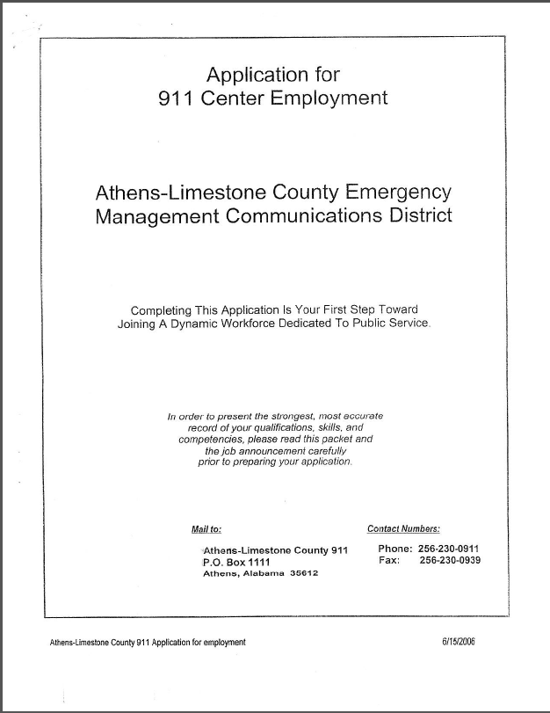
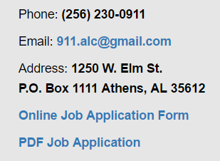
Create Job Application Form
Before Project
After Project
Applicant would complete a paper form
No website solution available
Applicant can complete an HTML form online. Information will be emailed directly to ALC911 staff.
Applicant may also download a PDF version of the job form.

Slide 5
Additional Form Functionality
Address Request Form
Job Application Form
Browser side form validation
Validation errors displayed in tooltips
Checkbox field transfers Requester Information to Resident Details
Google captcha installed to prevent spam
Form data emailed to Athens-Limestone County 911 group Gmail account on submit
Multi-page form due to high volume of fields (6 parts)
Browser side form validation
Validation errors displayed in tooltips
Each page must validate before proceeding to next
Dynamic form elements:
Education Information
Employment History
Google captcha installed to prevent spam
Form data emailed to Athens-Limestone County 911 group Gmail account on submit

Slide 6

Smart 911 Tab
Smart 911 is an automated delivery of a safety profile with personal and medical information that will better assist emergency personal during a 911 call.
Limestone County is the only county in North AL to utilize this feature and is one of only six counties in the entire state.
A dedicated Smart 911 tab was added to website. This tab contains Smart 911 related pictures and instructional videos as well as links to the Smart 911 website.

Slide 7
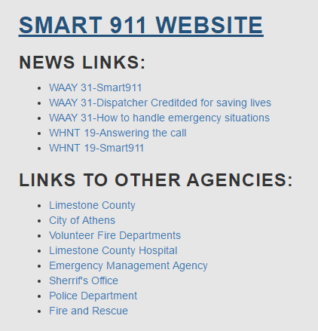
Update Links
Many of the existing links on the LINKS tab were broken and sent users to the wrong site. These were corrected.
Additional links were added: City of Athens, Volunteer Fire Department, Sherriff’s Office along with several other sites.

Slide 8
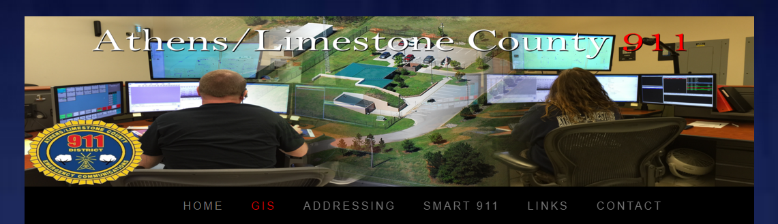
GIS Map
The GIS map originally appeared in a small window which made it difficult for users to be able to zoom in and look for a location.
The map now opens in a separate window as a full page, which greatly improves the map visibility.

Slide 9
Challenges
Lack of experience in web programming. To accomplish project deliverables, group members had to quickly learn HTML, CSS, JavaScript, and PHP.
Encryption for Social Security Number
Changing requirements:
Originally agreed upon building a backend database to house form data
After Sprint 2, client determined that a database would not be necessary due to low volume and requested an email instead
Handling dynamically created form elements in PHP

Slide 10
Going Forward
Create an administrative site and web-based user interface that allows ALC 911 staff to query database and review form data online
Complete website redesign

